Slide 1
Real Time Operating Systems

Slide 2
outline
Definition of real-time systems
Structure of typical real-time systems
Characteristics of Real-Time Systems
Examples of Real-Time Systems

Slide 3
Introduction to Real-Time Systems
What is a Real-Time System?
Is defined as a system in which the time where the outputs are produced is significant (within specified bounds or deadlines)
.
RTS
Actuator Outputs
Sensor Data
Commands
Displays
Correctness depends on output values and the time at which
the inputs are processed and the outputs are produced

Slide 4
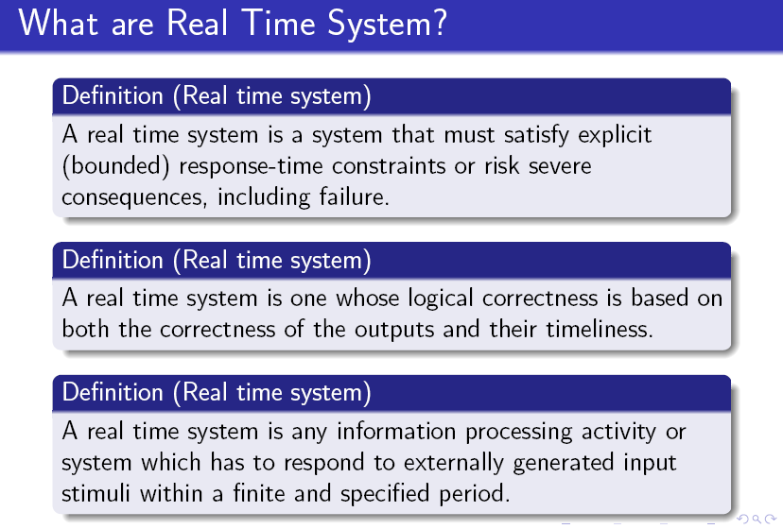

Slide 5
Introduction to Real-Time Systems
Real-time systems often are comprised of a controlling system, controlled system and environment.
A Controlling system: acquires information about the environment using sensors and controls the environment with actuators.
Timing constraints derived from physical impact of controlling systems activities. Hard and soft constraints.
Periodic Tasks: Time-driven recurring at regular intervals (e.g., sensors polling).
Aperiodic Tasks: event-driven (operator commands).

Slide 6
Typical Real-Time System
Operator Interface
Controlled System
Controlling
System
sensor
Environment
sensor
sensor
sensor
actuator
actuator
actuator
actuator

Slide 7
Examples of Real-Time Systems
Process Control and Manufacturing Systems
Operator
Commands
Displays
Controller
Sensor
Data
Control Signals
Raw Material
Plant
Finished Products

Slide 8
Real Time System Concept
Real-time systems are characterized by the severe consequences that result if logical as well as timing correctness properties of the system are not met.
There are two types of real-time systems: SOFT and HARD.
In a SOFT real-time system, tasks are performed by the system as fast as possible, but the tasks don’t have to finish by specific times.
In HARD real-time systems, tasks have to be performed not only correctly but on time.
Most real-time systems have a combination of SOFT and HARD requirements.
Real-time applications cover a wide range, but most real-time systems are embedded.
This means that the computer is built into a system and is not seen by the user as being a computer.
The following list shows a few examples of embedded systems.

Slide 9
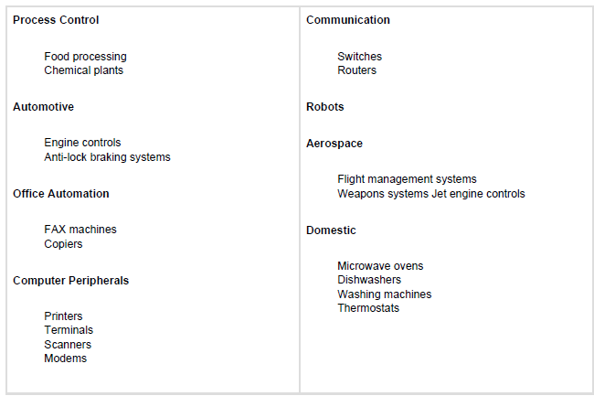
Examples

Slide 10
Task
A task, also called a thread, is a simple program that thinks it has the CPU all to itself.
The design process for a real-time application involves splitting the work to be done into tasks responsible for a portion of the problem

Slide 11
Each task typically is an infinite loop that can be in any one of five states: DORMANT, READY, RUNNING, WAITING (for an event), or ISR (interrupted).
The DORMANT state corresponds to a task that resides in memory but has not been made available to the multitasking kernel.
A task is READY when it can execute but its priority is less than the currently running task. A task is RUNNING when it has control of the CPU.
A task is WAITING when it requires the occurrence of an event (waiting for an I/O operation to complete, a shared resource to be available, a timing pulse to occur, time to expire, etc.).
Finally, a task is in the ISR state when an interrupt has occurred and the CPU is in the process

Slide 12
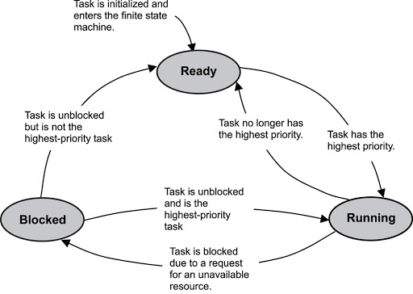

Slide 13
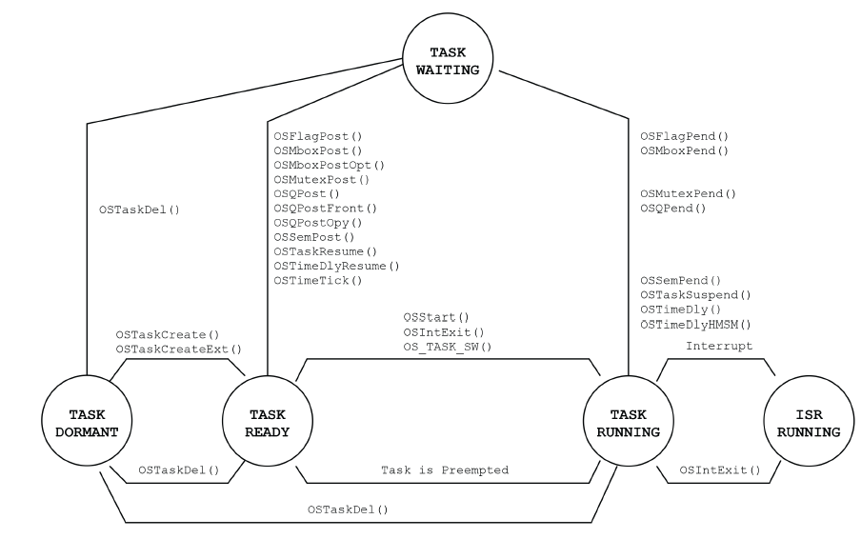
Task States

Slide 14
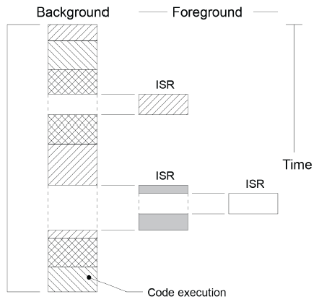
Foreground and Background Systems
Small systems of low complexity are generally designed as shown in Fig.
These systems are called foreground/background or super-loops.
An application consists of an infinite loop that calls modules (i.e., functions) to perform the desired operations (background).
Interrupt Service Routines (ISRs) handle asynchronous events (foreground).

Slide 15
Foreground is also called interrupt level; background is called task level.
Critical operations must be performed by the ISRs to ensure that they are dealt with in a timely fashion.
Because of this, ISRs have a tendency to take longer than they should.
Also, information for a background module made available by an ISR is not processed until the background routine gets its turn to execute. This is called the task level response.
The worst case task-level response time depends on how long the background loop takes to execute. Because the execution time of typical code is not
constant, the time for sucessive passes through a portion of the loop is non-deterministic.
Furthermore, if a code change is made, the timing of the loop is affected.

Slide 16
Multitasking
Multitasking is the process of scheduling and switching the CPU (Central Processing Unit) between several tasks; a single CPU switches its attention between several sequential tasks.
Multitasking is like foreground/background with multiple backgrounds. Multitasking maximizes the utilization of the CPU and also provides for modular construction of applications.
One of the most important aspects of multitasking is that it allows the application programmer to manage complexity inherent in real-time applications.
Application programs are typically easier to design and maintain if multitasking is used.

Slide 17
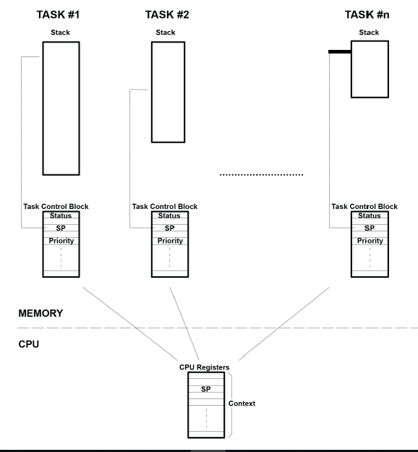
Example Multitasking

Slide 18
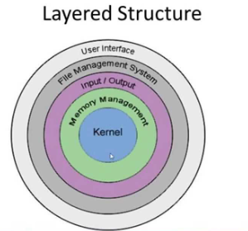
Layered Structure of OS

Slide 19
Kernel
The kernel is the part of a multitasking system responsible for the management of tasks (i.e., for managing the CPU’s time) and communication between tasks.
The fundamental service provided by the kernel is context switching. The use of a real-time kernel generally simplifies
the design of systems by allowing the application to be divided into multiple tasks managed by the kernel.

Slide 20
Scheduler
The scheduler, also called the dispatcher, is the part of the kernel responsible for determining which task will run next. Most real-time kernels are priority based.
Each task is assigned a priority based on its importance.
The priority for each task is application specific.
In a priority-based kernel, control of the CPU is always given to the highest priority task ready to run.

Slide 21
Non-Preemptive Kernel
There are two types of priority-based kernels: non-preemptive and preemptive.
Non-preemptive kernels require that each task does something to explicitly give up control of the CPU.
To maintain the illusion of concurrency, this process must be done frequently.
Non-preemptive scheduling is also called cooperative multitasking; tasks cooperate with each other to share the CPU.
Asynchronous events are still handled by ISRs.
An ISR can make a higher priority task ready to run, but the ISR always returns to the interrupted task.
The new higher priority task will gain control of the CPU only when the current task gives up the CPU.

Slide 22
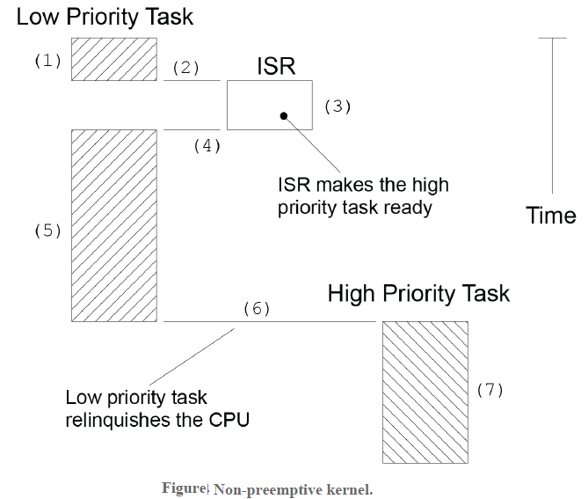
(1) A task is executing but gets interrupted.
(2) If interrupts are enabled, the CPU vectors (jumps) to the ISR.
(3) The ISR handles the event F2.4(3) and makes a higher priority task ready to run.
(4) Upon completion of the ISR, a Return From Interrupt instruction is executed, and the

Slide 23
(5) The task code resumes at the instruction following the interrupted instruction.
(6) When the task code completes, it calls a service provided by the kernel to relinquish the
CPU to another task.
(7) The kernel sees that a higher priority task has been made ready-to-run (it doesn’t
necessarily knows that it was from an ISR nor does it care) and thus, the kernel performs
a context switch so that it can run (i.e. execute) the higher priority task to handle the
event signaled by the ISR.

Slide 24
Preemptive Kernel
A preemptive kernel is used when system responsiveness is important.
Because of this, μC/OS-II and most commercial real-time kernels are preemptive.
The highest priority task ready to run is always given control of the CPU.
When a task makes a higher priority task ready to run, the current task is preempted (suspended) and the higher priority task is immediately given control of the CPU.
If an ISR makes a higher priority task ready, when the ISR completes, the interrupted task is suspended and the new higher priority task is resumed.

Slide 25
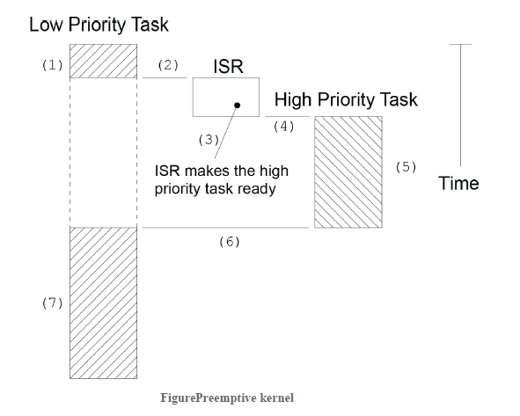
A task is executing but gets interrupted.
(2) If interrupts are enabled, the CPU vectors (jumps) to the ISR.
(3) The ISR handles the event and makes a higher priority task ready to run.

Slide 26
Upon completion of the ISR, a service provided by the kernel is invoked (i.e. a function provided by the kernel is called).
(4) & (5) This function knows that a more important task has been made ready-to-run and thus, instead of returning back to the interrupted task, the kernel will perform a context switch and execute the code of the more important task.
When the more important task is done, another function provided by the kernel is called to put the task to sleep waiting for the event (i.e. the ISR) to occur.
(6) & (7) The kernel then ‘sees’ that a lower priority task needs to execute and another context switch is done to resume execution of the interrupted task.

Slide 27
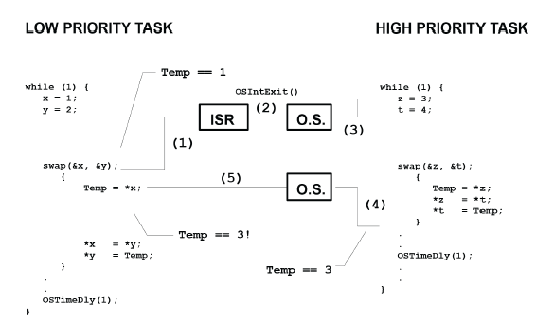
Non-reentrant function.

Slide 28
Round-Robin Scheduling
When two or more tasks have the same priority, the kernel allows one task to run for a predetermined amount of time, called a quantum, then selects another task.
This is also called time slicing.
The kernel gives control to the next task in line
if the current task has no work to do during its time slice or
the current task completes before the end of its time slice or
the time slice ends.

Slide 29
Task Priority
A priority is assigned to each task. The more important the task, the higher the priority given to it.
With most kernels, you are generally responsible for deciding what priority each task gets.
Static Priorities
Task priorities are said to be static when the priority of each task does not change during the application’s execution.
Each task is thus given a fixed priority at compile time.
All the tasks and their timing constraints are known at compile time in a system where priorities are static.

Slide 30
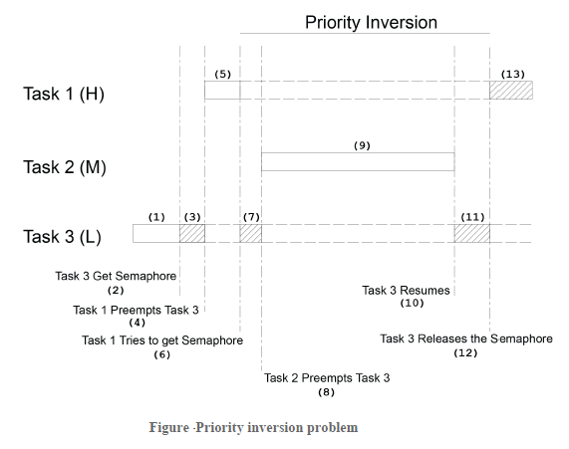
Dynamic Priorities
Task priorities are said to be dynamic if the priority of tasks can be changed during the application’s execution; each task can change its priority at run time.
This is a desirable feature to have in a real-time kernel to avoid priority inversions.
Priority Inversions
Priority inversion is a problem in real-time systems and occurs mostly when you use a
real-time kernel. illustrates a priority inversion scenario. Task 1 has a higher priority
than Task 2, which in turn has a higher priority than Task 3.

